Slide 1
The Union in Crisis (1846-1861)
Chapter 10

Slide 2
Slavery and States’ Rights
Section 1

Slide 3
Slavery Divides the Nation
North
South
Busy cities
Technology
Factories / paid workers
Immigrants
Farms
Cotton
Southern planters
Slave labor

Slide 4
View on Slavery
Northern
Southern
Ended early in the North
Some were ABOLITIONISTS
Wanted an end to slavery in the entire nation
Some were PRO-SLAVERY
Pro-slavery
Believed they treated slaves better than Northern factories

Slide 5
New States
Free-Soilers
Popular Sovereignty
Believe ALL new states should be free of slavery
Believed each new state should VOTE on the issue of slavery

Slide 6
California and Balance of Power
80k move to CA in 1 year (Gold Rush) / realize they need a GOVT.
1849 CA admitted to the U.S as a FREE STATE
Southerners angry they were losing power
Threaten to SECEDE (leave) if a compromise is not made

Slide 7
Compromise of 1850
Henry Clay of Kentucky:
1. CA admitted as free state
2.NM and UT to decide on slavery
3. Sale of slaves abolished (outlawed) in D.C
4. Fugitive Slave Act enforced

Slide 8
Fugitive Slave Act
Forced govt. officials from the North to return any runaway slaves to the South
Leads to BOUNTY HUNTING of all African Americans in the North
Americans (North and South) avoid crisis…..for now

Slide 9
Section 1 Review:
1. List some differences between the NORTH and SOUTH.
2. How were the North and South’s view on slavery different?
3. What does the term POPULAR SOVEREIGNTY mean?
4. List 2 parts of the Compromise of 1850.

Slide 10
A Rising Tide of Violence
Section 2

Slide 11
Northern Africans Mobilize
Christiana, PA a slave owner is killed trying to regain a slave
No one is CHARGED for the murder
Blacks and whites begin protesting the FUGITIVE SLAVE ACT

Slide 12
Underground Railroad
Not an actual “RAILROAD”
System of farm wagons, riverboats and secret hiding places
Slaves could use it to escape from the SOUTH to the NORTH

Slide 13
Harriet Tubman (Abolitionist)
Nickname “Black Moses” for helping free her people
Most courageous Underground Railroad Conductor
24 trips from North to South
Large reward for her capture (penalty is death)

Slide 14
Harriet Beecher Stowe
Wrote “Uncle Tom’s Cabin”
2nd best selling book of the decade
Gave 1st hand account of the horrors of slavery in the SOUTH

Slide 15
Kansas Nebraska Act (1854)
Proposed by S. Douglas of Illinois
Allowed the people to decide if they wanted slavery or not (popular sovereignty) in new territories
Problem: Only white males are voting

Slide 16
Violence
Kansas Nebraska Act leads to violence known as “Bleeding Kansas” 1856
Mini Civil War
Free Soilers vs. pro slavers (over slavery)
John Brown kills pro slavers in Kansas

Slide 17
Violence in the Senate
Bleeding Sumner 1856
Preston Brooks beat Sen. Charles Sumner with his cane on the floor of the Senate for ANTI SLAVE speech
Breaks several bones
Both men become heroes for this cause

Slide 18
Section 2 Review:
1. Describe the Underground Railroad.
2. What is Harriet Tubman known for?
3. Who fought in BLEEDING KANSAS? What was it over?
4. Describe the event BLEEDING SUMNER.

Slide 19
Political Realignment Deepens the Crisis
Section 3

Slide 20
Whig Party Disintegrates
Means “Oppose tyranny”
Exist in both the South and North
Existed to weaken the power of the president
Could not agree on SLAVERY so they break up

Slide 21
Know-Nothings Attract Support
A.K.A American Party
Time of immense Irish, Italian and Catholic immigration (mostly due to famine)
Anti-immigrant
Believed immigrants loyalty was not to AMERICA

Slide 22
Republican Party is Born
Nickname: GOP (Grand Old Party)
1854 – Anti slave platform
Picked up members of any party that had dissolved who were anti slave as well
Led eventually by ABRAHAM LINCOLN
19 Presidents elected (most all time)

Slide 23
Election of 1856
James Buchanan wins by promising to end the slavery issue forever
Northerner who was supported by many Southern states
Only president from PA ever elected
Largely considered WORST president of all time

Slide 24
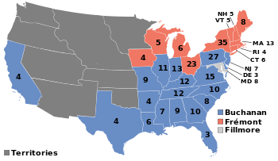
Buchanan Wins (174-114)

Slide 25
Dred Scott Case
Missouri slave who sued for his freedom
Court ruled against Scott claiming all slaves were PROPERTY
South celebrates
North ponders SECESSION (leaving)

Slide 26
Lincoln - Douglas Debates
Honest Abe (Lincoln)
Little Giant ( Douglas)
Grew up in rural poverty
Against EXPANSION of slavery (at 1st)
Loses election / wins a good reputation
Supported in both North and South
Believe in POPULAR SOVEREIGNTY (vote) on slavery

Slide 27
Section 3 Review:
1. What does the term Whig Party mean? Why did they break up?
2. What was the stance of the KNOW-NOTHING Party?
3. What was the stance of the REPUBLICAN Party? Who was their leader?
4. What was the ruling in the Dred Scott case?

Slide 28
Secession and War!
Section 4

Slide 29
Election of 1860
Democrats (split in 2)
Northern: Stephen Douglas
Southern: John Breckinridge
Constitutional Union Party
John Bell (TN)
Republican
Abraham Lincoln

Slide 30
Results
Lincoln wins with only 39% of popular vote
Wins 0 southern electoral votes
South realizes they have no sway (influence) over the union
SC secedes (leaves the U.S) on Dec. 20, 1860

Slide 31
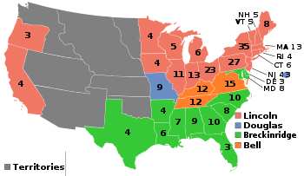
Lincoln Wins! 180 Electoral Votes

Slide 32
Confederate States of America
Exists between 1861-1865
Unrecognized country illegally formed by 7 U.S States
Jefferson Davis elected president
Relied upon labor of African-American Slaves

Slide 33
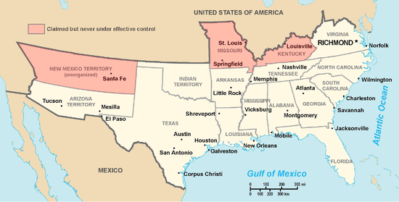
Confederacy

Slide 34
Fort Sumter (South Carolina)
Held by Union (Northern) troops who refuse to surrender it
CSA opens fire on April 12, 1861
Act of war which starts the American Civil War with the SOUTH (Confederacy) as the aggressor

Slide 35
Section 4 Review:
1. Who runs from EACH political party in the election of 1860?
2. What % of the popular vote did Lincoln win? How many southern electoral votes?
3. Which FORT was attacked that started the Civil War? What state was it in?
4. List at least 5 of the states in the CONFEDERACY. (page 365)

